Slide 1
Video Sequence Prediction and Generation with Advanced Deep Learning Architectures
I210653
I210813
i212493

Slide 2
Abstract
Objective: Develop deep learning models to predict and generate
future frames in video sequences.
Dataset: UCF101 dataset.
Models Implemented:
ConvLSTM
PredRNN
Transformer-based model
Metrics: Evaluated using Mean Squared Error (MSE) and Structural Similarity Index (SSIM).
Outcome: Comparison of the models for performance, efficiency, and
computational requirements.

Slide 3
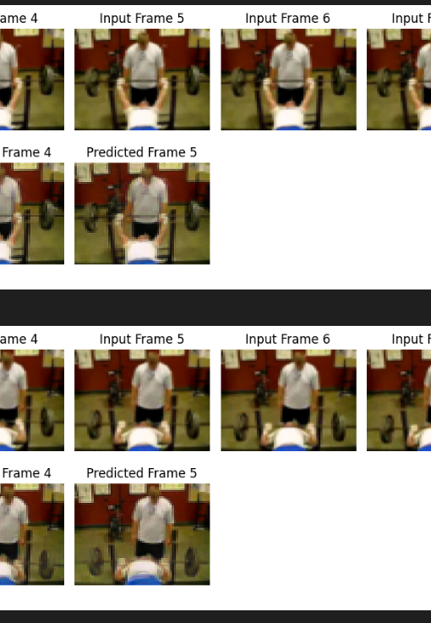
Problem Definition
Goal: Predict future frames from past frames in a video
Challenges:
Capturing spatial and temporal dependencies.
Ensuring that generated frames have spatial consistency and temporal coherence.

Slide 4

Importance of Video Sequence Prediction
Autonomous Driving: Predicting movement of objects and enhancing decision-making.
Video Production: Filling missing frames to improve editing efficiency.
Robotics: Predicting movement and actions over time.

Slide 5
Related Work
ConvLSTM: Integrates CNN and LSTM, good for short sequences but
struggles with long-term dependencies.
PredRNN: Incorporates spatiotemporal memory to handle long-range
dependencies better than ConvLSTM.
Transformer: Uses self-attention for modeling long-term dependencies,
but requires substantial computational resources.

Slide 6
Approach Overview
Models Implemented:
ConvLSTM: Convolutional LSTM layers for spatial and temporal learning.
PredRNN: Improved ConvLSTM with a spatiotemporal memory layer.
Transformer: Self-attention mechanism for long-range dependencies.
Dataset: UCF101 – contains a wide variety of action sequences for training.

Slide 7
Data Preprocessing
Frame Resizing: Reduced to 64x64 for faster training.
RGB Conversion: Maintains color information for better video quality.
Normalization: Scaled and normalized pixel values for quicker convergence.
Stride Sampling: Skipping frames for efficient training without losing key temporal information.

Slide 8
Model Architectures
ConvLSTM:Combines CNN for spatial features with LSTM for temporal dependencies.
Suitable for short-term video prediction.
PredRNN:Incorporates a spatiotemporal memory layer for improved long-range temporal modeling.
Transformer:
Uses self-attention to handle long-term dependencies.
Split video into patches and use multiple Transformer blocks.

Slide 9
Training Process
Optimizer: Adam optimizer with an initial learning rate of 1e-3.
Batch Size: 16 (chosen based on memory requirements).
Learning Rate Scheduler: Adjusts the learning rate based on loss or
SSIM to improve convergence.
Epochs:
ConvLSTM: 8 epochs.
PredRNN: 20 epochs.
Transformer: 100 epochs.

Slide 10
Performance Evaluation
Metrics: MSE (Mean Squared Error): Measures pixel-level error.
SSIM (Structural Similarity Index): Measures perceptual quality based on luminance, contrast, and structure.
MODEL | MSE | SSIM
ConvLSTM | 0.0304 | 0.7171
PredRNN | 0.0352 | 0.6967
Transformer | 0.0269 | 0.6125

Slide 11
ConvLSTM Performance
Strength: Good for short sequences, fast training.
Limitation: Struggles with learning long-term temporal dependencies.
Outcome: Spatially consistent predictions but fails in complex, long-term sequences.

Slide 12
PREDRNN Performance
Strength: Excellent at capturing long-term dependencies and maintaining temporal coherence.
Limitation: Requires more computational resources and time.
Outcome: Smoother frame transitions, better motion representation, especially in longer sequences.

Slide 13
Transformer Performance
Strength: Can learn long-term dependencies effectively.
Limitation: High computational cost, less stable for short sequences.
Outcome: While learning complex patterns, performance on shorter sequences was lower compared to other models.

Slide 14
Comparison of Results
PredRNN: Best performance, especially for long sequences and temporal continuity.
ConvLSTM: Best for shorter sequences, computationally efficient.
Transformer: High computational cost and instability on shorter sequences, but excelled at learning long-term dependencies.

Slide 15
Conclusion
PredRNN proved to be the best for long video sequences with intricate temporal dynamics.
ConvLSTM is ideal for short video sequences due to its simplicity and lower computational cost.
Transformer models, although powerful in handling long-term dependencies, were not the best choice in terms of performance and computational efficiency for this task.
Key takeaway: The choice of model depends on the sequence length and available computational resources.

Slide 16
References
J. Amogh, "Keras documentation: Next-Frame Video Prediction with Convolutional LSTMs," Keras.io. [Online]. Available: https://keras.io/examples/vision/convlstm/.
Y. Wang, Z. Gao, M. Long, J. Wang, and P. S. Yu, "PreDRNN++: Towards a Resolution of the Deep-in-Time Dilemma in Spatiotemporal Predictive Learning," arXiv.org, Apr. 17, 2018. [Online]. Available: https://arxiv.org/abs/1804.06300.
iamrakesh28, "Video-Prediction: Implementation of Transformer Encoder Decoder Architecture for Video Predictions," GitHub. [Online]. Available: https://github.com/iamrakesh28/Video-Prediction.

Slide 17
Thank you

